Slide 1


Green Pace
Security Policy Presentation
Developer: Jonathan Boeglin

Slide 2

OVERVIEW: DEFENSE IN DEPTH
Green Pace software requires consistent implementation of secure principles.
Consistent approaches and methodologies maintained to support Defense-in-Depth.
Policy definitions:
Core security principles
C/C++ coding standards
authorization, authentication, and auditing standards
data encryption standards

Slide 3
THREATS MATRIX
Likely STD-003-CPP STD-004-CPP STD-005-CPP STD-007-CPP STD-008-CPP STD-010-CPP | Priority STD-003-CPP STD-004-CPP STD-005-CPP STD-007-CPP STD-010-CPP
Low priority STD-001-CPP STD-002-CPP STD-008-CPP | Unlikely STD-001-CPP STD-002-CPP STD-006-CPP STD-009-CPP
Automated code-checkers like Parasoft C/C++test or Polyspace Bug Finder can be used to identify these threats.

Slide 4
10 PRINCIPLES
Validate Input Data
STD-003-CPP
STD-010-CPP
Heed Compiler Warnings
Architect and Design for Security Policies
STD-004-CPP
STD-010-CPP
Keep it Simple
STD-002-CPP
STD-004-CPP
STD-006-CPP
STD-008-CPP
STD-009-CPP
Default Deny
STD-003-CPP
Adhere to the Principle of Least Privilege
STD-005-CPP
Sanitize Data Sent to Other Systems
Practice Defense in Depth
Use Effective Quality Assurance Techniques
STD-001-CPP through STD-010-CPP
Adopt a Secure Coding Standard
STD-001-CPP through STD-010-CPP

Slide 5
CODING STANDARDS
STD-007-CPP
STD-004-CPP
STD-003-CPP
STD-005-CPP
STD-010-CPP
STD-006-CPP
STD-008-CPP
STD-009-CPP
STD-001-CPP
STD-002-CPP
Priority given to high severity, likely to happen standards (7,4,3,5,10)
Low likelihood, low severity standards saved for last (1,2)
Middle-of-the-road cases need to be monitored but are less urgent (6,8,9)

Slide 6
ENCRYPTION POLICIES
Encryption in rest
For data that is being stored or is not actively being used
Sensitive data needs safe storage
Varying levels of security for data based on its volatility
Encryption in flight
For data that is currently being sent between destinations
Ex: Emails, various app messages, or through other public means
Security for possible mishandling of data, such as data breaches or leaks.
Encryption in use
For data actively being accessed and manipulated
Ex: Reading, writing to, or creating a file
An application of this policy would be protection from attempts to steal user information, like passwords.

Slide 7
TRIPLE-A POLICIES
Authentication
Process of a user giving details on themselves to be applied in the future for verification
Used to confirm people accessing a program are genuine
Addition of new users also handled
Authorization
Protects data from the wrong people by user access levels
Allows users to access different parts of a network or program depending on their privileges
Ex: Restriction of accessing and making changes to a website’s database
Accounting
Helps prevent future issues by keeping a record of past events
Done through recording of users through their data
Can be applied when a security breach occurs, as the offender can be determined from the access data gathered during the attack

Slide 8
Unit Testing
The coding vulnerabilities being tested are the issues that arise with containers. Proper ranges and sizes need to be tested to prevent buffer flow errors. In addition, making sure relevant functions work properly with the container is important.

Slide 9
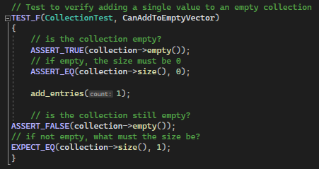
CanAddToEmptyVector
Code
Result

Slide 10
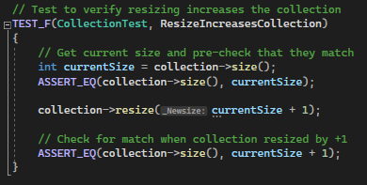
ResizeIncreasesCollection
Code
Result

Slide 11
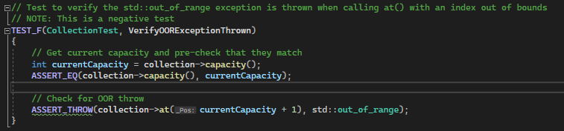
VerifyOORExceptionThrown
Code
Result

Slide 12
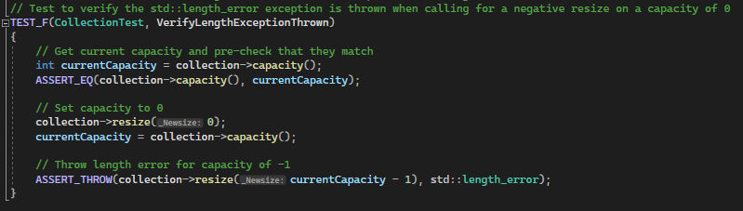
VerifyLengthExceptionThrown
Code
Result

Slide 13
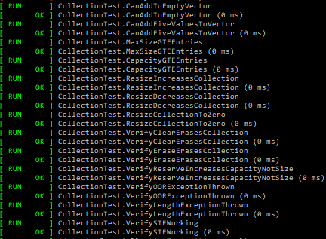
Results of All Tests

Slide 14

AUTOMATION SUMMARY

Slide 15
TOOLS
Automation of security practices during pre-production and production
Secure procedures are added to the planning, design, building, testing, and maintenance stages of DevOps
Production process:
Monitoring for threats and responding to any attacks
Maintenance includes stabilization after attacks, and rollout of updates include live testing of security measures
Pre-production:
Steps stay mostly the same as DevOps
Addition of security planning, design, and integration during the appropriate times
Automation tools will help enforce the standards within this policy
Will take place during the building and verification and testing phases of pre-production
In addition, any updates to the tools that catch new issues can be run during production on the code during maintenance and any necessary updates can be added to the cycle.

Slide 16
RISKS AND BENEFITS
Pros
Cons
Upfront integration can save time
Project is secure at every step
Certain security measures can help with code readability and conciseness
Extra cost of time and money
Training/new employees may be needed
Acting too quickly can have adverse effects

Slide 17
RECOMMENDATIONS
Not all coding standard rules are covered, addition of standards for those areas are needed
Rule 1, 2, 5, 6, and 8 are covered, at least one standard from the rest should be implemented
Not all coding principles are covered by current policy standards
Addition of at least one standard per missed principle is needed
Current policy and additions should be reviewed by several editors to avoid bias from authors

Slide 18
CONCLUSIONS
Adopting select standards from each missing rule of the main C++ coding standard can avoid any future issues that may arise had they remained absent
For example, adopting CTR53-CPP can help prevent invalid iterators
This is an important check as it is now harder to find iterator issues, as stated here:
https://lightcone.medium.com/iterator-invalidation-in-modern-c-ca0f3c161c5f
Following the 10 principles will help cover any gaps left that are not covered by any of the adopted standards
Use compartmentalization to make future additions to security easier

Slide 19
REFERENCES
**All standard description, compliant and non-compliant, threat level, and automation sections taken directly from the SEI CERT C++ Coding Standard website.
Admin et al. (2023, September 5). Sei cert C++ coding standard. SEI CERT C++ Coding Standard - SEI CERT C++ Coding Standard - Confluence. https://wiki.sei.cmu.edu/confluence/pages/viewpage.action?pageId=88046682
Dinic, M. (2023, August 16). Encryption: Data at rest, data in motion and data in use. Jatheon Technologies Inc. https://jatheon.com/blog/data-at-rest-data-in-motion-data-in-use/
Fortinet, Inc. (2023). What is AAA Security?. Fortinet. https://www.fortinet.com/resources/cyberglossary/aaa-security

